Slide 1
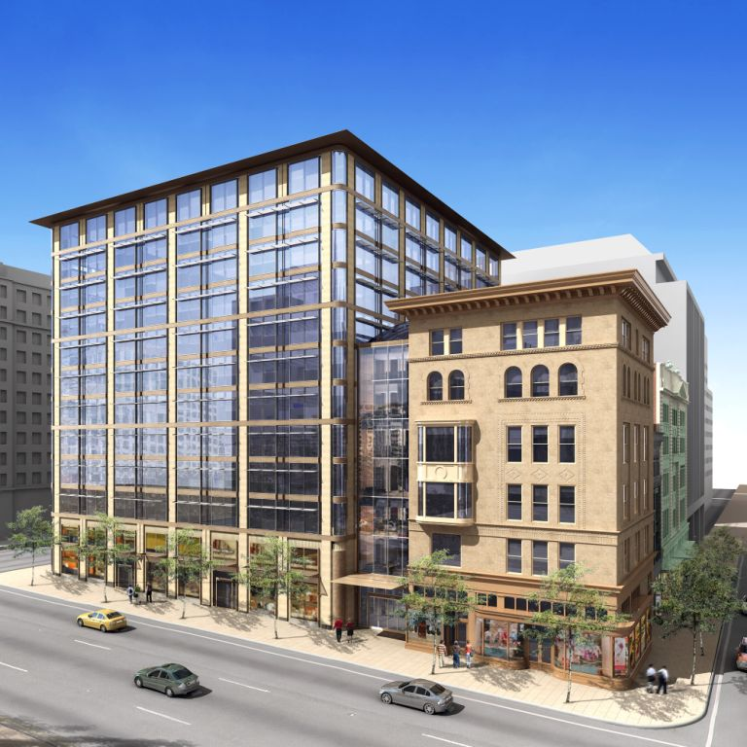
SQUARE 320
1199 F Street, NW – Wash, DC
Michael Webb
Charleston, South Carolina
Architectural Engineering
Construction Management
The Pennsylvania State University
Senior Thesis Presentation 2009

Slide 2
SQUARE 320 Project
“Enabling Synergy Among Renovation Teams”
Project Overview
Size
  485,000 SF; 15 stories
Cost
  $60 million
Schedule
  Dec 2006 – April 2009

Slide 3
SQUARE 320 Project
“Enabling Synergy Among Renovation Teams”
Project Overview
Project Background
Construction of 12-story Class A Office Space
Renovation of 3 historic buildings
Rejuvenating the District’s East End
Total Duration: 30 months
Currently at 85% Leased Tenants
Size
  485,000 SF; 15 stories
Cost
  $60 million
Schedule
  Dec 2006 – April 2009

Slide 4
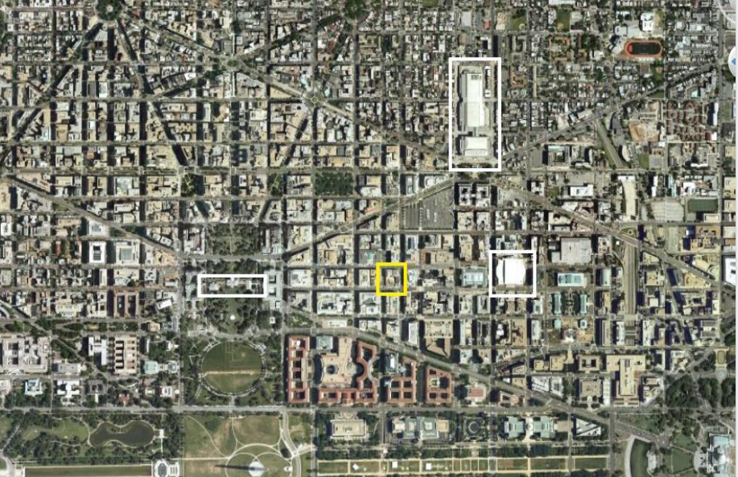
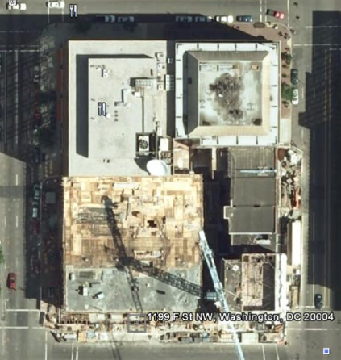
SQUARE 320 Project
“Enabling Synergy Among Renovation Teams”
Major Players
Centrally Located
1199 F Street
Wash DC, NW
Owner
  Douglas Development
Architects
  Pei Cobb Freed
  Shalom Baranes
  HKS, PC
Construction Manager
  James G. Davis
National Mall, Verizon Ctr, White House, DC Convention Ctr

Slide 5
SQUARE 320 Project
“Enabling Synergy Among Renovation Teams”
Project Details
Size
  Class A Office : 350,000 SF
  Retail Shops : 30,000 SF
  Parking : 75,000 SF

Slide 6
SQUARE 320 Project
“Enabling Synergy Among Renovation Teams”
Project Details
Project Details
Size
  Class A Office : 350,000 SF
  Retail Shops : 30,000 SF
  Parking : 75,000 SF
  Project Delivery System
  CM @ Risk with GMP
Height
  12-Stories Above Grade
  5-Stories Below Grade
Structure
  Renovation
    Steel Frame w/ Deck
  Tower
    Post-Tensioned Concrete

Slide 7
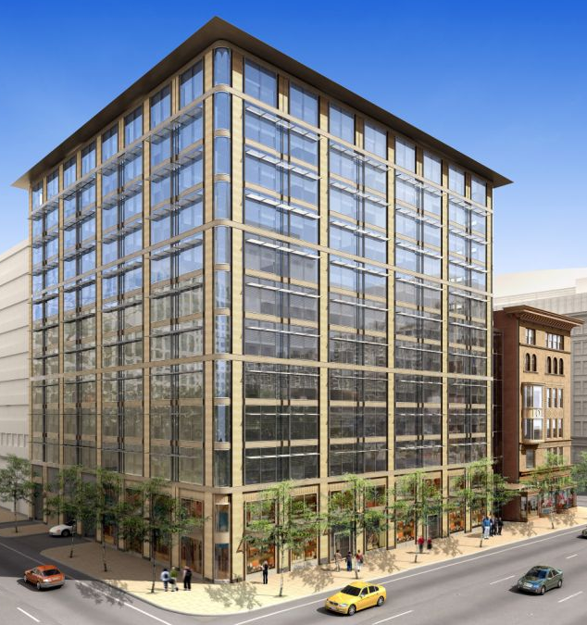
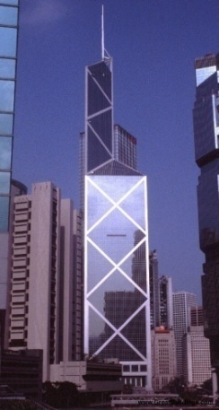
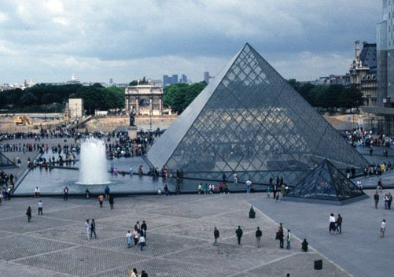
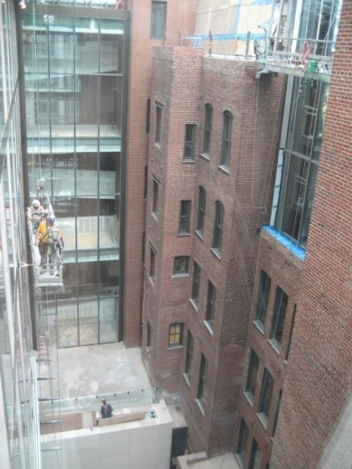
SQUARE 320 Project
“Enabling Synergy Among Renovation Teams”
Project Architecture
  Office Tower
New Construction
  Office Tower
  Historic Renovations
  Barry Whitmore
  Corcoran
  Nordlinger
  Custom curtain-wall,
  signature design of IM Pei
  Lobby Atrium heavily appointed with granite, marble, copper
  Luxurious bathrooms to attract wealthy tenants
Atrium

Slide 8
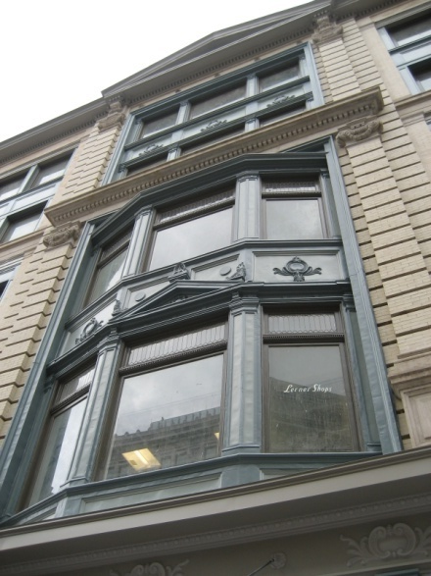
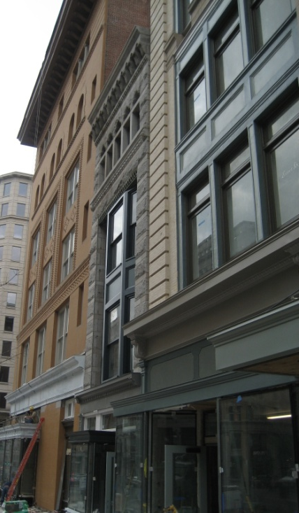
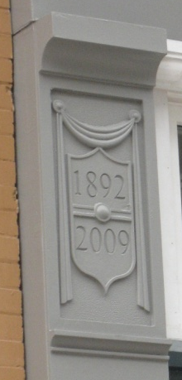
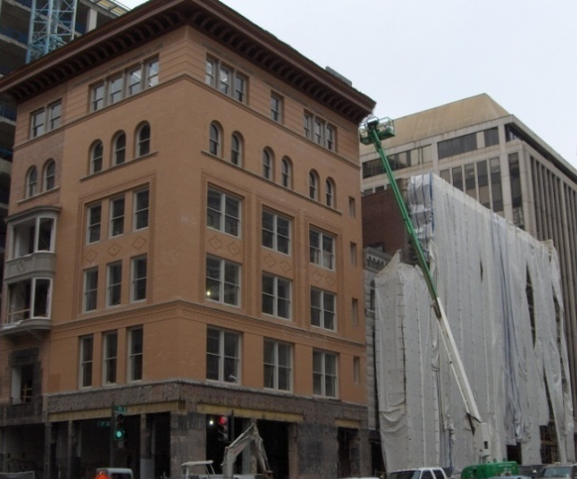
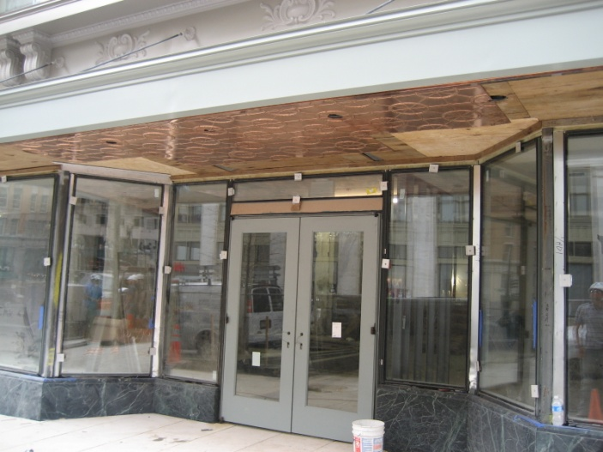
SQUARE 320 Project
“Enabling Synergy Among Renovation Teams”
Project Architecture
  Historic Renovations
New Construction
  Office Tower
  Historic Renovations
  Barry Whitmore
  Corcoran
  Nordlinger
    Re-appoint brick façade
    Restored Granite stonework
    Replace ornamental metal décor at storefront
    Recreate facade of 1892
1892 - 2009

Slide 9
SQUARE 320 Project
Scope: Renovation Work
  Historical Renovations
  => Growing Market
  Energy cost savings in the name of sustainability
  Require less capital & incur less risk

Slide 10
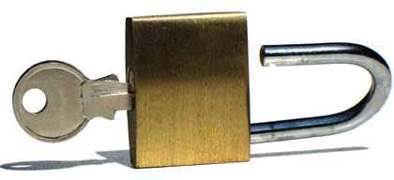
SQUARE 320 Project
“Enabling Synergy Among Renovation Teams”
Overarching Theme
Methods that will unlock the potential synergy among renovation teams
Various parties are united to achieve greater success as a whole

Slide 11

SQUARE 320 Project
What is Synergy?
2 agents acting together such that the whole is greater than the sum of its parts’
5 + 5 = 15
Overview of the Research Results
3 Distinct Areas that when combined will unlock the potential for success

Slide 12
SQUARE 320 Project
3 Focus Areas
Cohesion
  Information-Time-Money Relationship
Innovation
  Forward Thinking teams
Emotional Intelligence
  Monitoring the project climate & developing working relationships

Slide 13
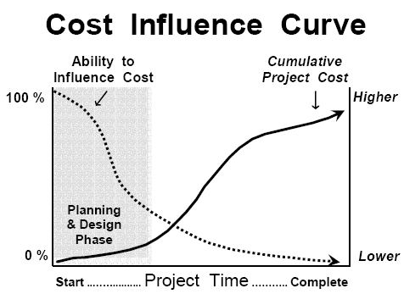
“Enabling Synergy Among Renovation Teams”
SQUARE 320 Project
Overview of Results
3 Focus Areas
Cohesion
  Information-Time-Money Relationship
Innovation
  Forward Thinking teams
Emotional Intelligence
  Monitoring the project climate & developing team relationships
Cohesion
Information-Time-Money Relationship:
(Info) ⁻¹ = Time + Money
More Information Early
+ Enhances Communication
Efficient Better Quality Work, Less Stress, Happiness & Job Satisfaction
3D Laser Surveying (Info) + Major Players Meetings = Teamwork , Unity
Notes:
There is an inverse relationship between information and both time and money. The level of information any given team has on the project inversely equates to more efficient production rates and fewer delays from RFIs or hidden conditions. More efficient production rates relate directly to that portion of labor requiring less time for completion. If the job is completed faster, fewer resources need to be dedicated to the work and that aspect of the construction costs less as manpower and resources are used more efficiently.

Slide 14
“Enabling Synergy Among Renovation Teams”
SQUARE 320 Project
Overview of Results
3 Focus Areas
Cohesion
  Information-Time-Money Relationship
Innovation
  Forward Thinking teams
Emotional Intelligence
  Monitoring the project climate & developing team relationships
Innovation
Need Cohesive Teams to be Forward Thinking
Utilize alternative technology or re-designed systems
  Avoid design decisions that result in severe financial penalties
  Potential savings for each party involved
Notes:
Forward Thinking = asking the right questions, where will things go wrong? Thinking critically…
Willing to utilize

Slide 15
“Enabling Synergy Among Renovation Teams”
SQUARE 320 Project
Overview of Results
3 Focus Areas
Cohesion
  Information-Time-Money Relationship
Innovation
  Forward Thinking teams
Emotional Intelligence
  Monitoring the project climate & developing team relationships
Emotional Intelligence
Ability to perceive one’s emotions and those in other relationships
Used as a tool = Monitoring agent that tracks development among people & teams
Insight into each individual & project climate simultaneously
Enables focused efforts at benefiting each individual & project
Allows tailoring project climate to highlight teams strengths
…Ultimately, enabling synergy among renovation teams

Slide 16
“Enabling Synergy Among Renovation Teams”
SQUARE 320 Project
What is the Diagnosis?
What is the Diagnosis?
Square 320 was plagued with many challenges:
  Concealed Conditions - missing or incorrect documents
  Poor communication between all parties
  RFIs lasting 100+ days
  Months of delays
  Additional costs
  Frustrating project climate
  Lack of accountability & job ownership

Slide 17
“Enabling Synergy Among Renovation Teams”
SQUARE 320 Project
3 Focus Areas
Cohesion
  Lack of Information, 3D Laser Surveying, Corcoran Stair
Innovation
  Basement Expansion, Financial Perspective, Value of Thinking Forward
  Recouping the Loss through Mechanical & Structural Redesign
Emotional Intelligence
  Poor Working Climate, EQ Assessment, Office vs Field Dynamic

Slide 18
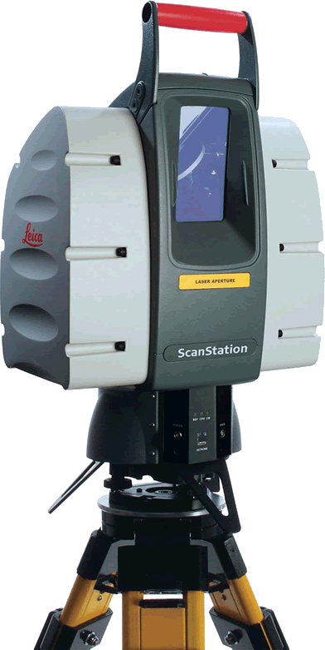
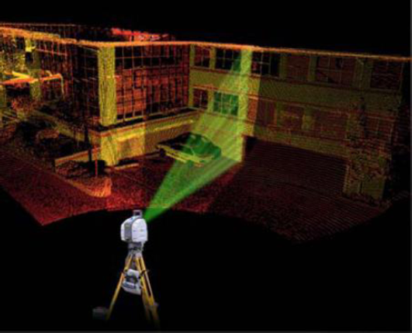
“Enabling Synergy Among Renovation Teams”
SQUARE 320 Project
Cohesion
3 Focus Areas
Cohesion
  Lack of Information, 3D Laser Surveying, Corcoran Stair
Innovation
  Basement Expansion, Financial Perspective, Value of Thinking Forward
  Recouping the Loss through Mechanical & Structural Redesign
Emotional Intelligence
  Poor Working Climate, EQ Assessment, Office vs Field Dynamic
Problems
  Concealed Conditions
  Missing or incorrect drawings
  Lack of Information
  Disconnected Team
  RFIs left open indefinitely
Strategy
  Utilize 3D Laser Surveying
  Selective Demolition
  Accurately map existing conditions
Notes:
The raw field information is stored and can be used to measure point-to-point distances or for the creation of 3D visualization. The point cloud, as seen in the image below, encompasses all of the relative distance data based on one common landmark.
In order to scan entire buildings, the equipment can make several scans at different positions, find common locations and use those to triangulate a base coordinate system. From that coordinate system the individual point cloud scans can be combined into a single file. These files, while they resemble 3D designs, still need to be adapted in a computer before they can be used as design tool. But, as seen below, these 3D scans can be joined to have all of the measurements in one single file, precise and accurate to the nearest 1/8th inch.
In the field of historical renovation work, 3D laser scanning technology has become more desirable because the equipment can collect extremely accurate data in only a matter of hours rather than the traditional weeks. Once these files are created by the surveyor, they can then be offered as deliverables to the owner or designer as a 3D design.
Industry research has determined that with historical renovation work, 3D scanning technology can not only reduce field work and improve efficiency but also provide a variety of deliverables like a 3D model or CAD as-built drawings that will significant expedite the design process.
All of these reasons encourage the future application of laser scanning to all historical architectural surveying, renovation, and restoration.

Slide 19
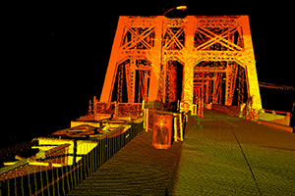
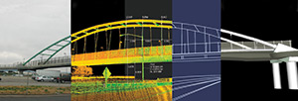
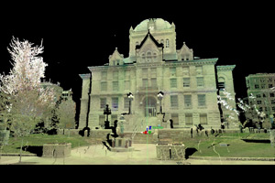
“Enabling Synergy Among Renovation Teams”
SQUARE 320 Project
Cohesion
3 Focus Areas
Cohesion
  Lack of Information, 3D Laser Surveying, Corcoran Stair
Innovation
  Basement Expansion, Financial Perspective, Value of Thinking Forward
  Recouping the Loss through Mechanical & Structural Redesign
Emotional Intelligence
  Poor Working Climate, EQ Assessment, Office vs Field Dynamic
Problems
  Concealed Conditions
  Missing or incorrect drawings
  Lack of Information
  Disconnected Team
  RFIs left open indefinitely
Strategy
  Utilize 3D Laser Surveying
  Selective Demolition
  Accurately map existing conditions
What is Laser Surveying?
  LIDAR (Light Detection and Ranging)
  Laser pulses reflect and create 3D image
  Scanning maps out 3D point cloud
  Reduces field work & improve efficiency
  3D Models used in 3D BIM design expedite process
  Frequently used for historical surveying & renovations
Notes:
The raw field information is stored and can be used to measure point-to-point distances or for the creation of 3D visualization. The point cloud, as seen in the image below, encompasses all of the relative distance data based on one common landmark.
In order to scan entire buildings, the equipment can make several scans at different positions, find common locations and use those to triangulate a base coordinate system. From that coordinate system the individual point cloud scans can be combined into a single file. These files, while they resemble 3D designs, still need to be adapted in a computer before they can be used as design tool. But, as seen below, these 3D scans can be joined to have all of the measurements in one single file, precise and accurate to the nearest 1/8th inch.
In the field of historical renovation work, 3D laser scanning technology has become more desirable because the equipment can collect extremely accurate data in only a matter of hours rather than the traditional weeks. Once these files are created by the surveyor, they can then be offered as deliverables to the owner or designer as a 3D design.
Industry research has determined that with historical renovation work, 3D scanning technology can not only reduce field work and improve efficiency but also provide a variety of deliverables like a 3D model or CAD as-built drawings that will significant expedite the design process.
All of these reasons encourage the future application of laser scanning to all historical architectural surveying, renovation, and restoration.

Slide 20
“Enabling Synergy Among Renovation Teams”
SQUARE 320 Project
Cohesion
3 Focus Areas
Cohesion
  Lack of Information, 3D Laser Surveying, Corcoran Stair
Innovation
  Basement Expansion, Financial Perspective, Value of Thinking Forward
  Recouping the Loss through Mechanical & Structural Redesign
Emotional Intelligence
  Poor Working Climate, EQ Assessment, Office vs Field Dynamic
Will It Work?
  Davis experts say NO!
  Concealed Conditions
  Tenants must keep working
  Technology not used at its full potential
Alternative Strategy
  Utilize 3D laser surveying in Corcoran stair well
  Design process took over a year
  All attention should’ve been placed there at the start.
Notes:
The raw field information is stored and can be used to measure point-to-point distances or for the creation of 3D visualization. The point cloud, as seen in the image below, encompasses all of the relative distance data based on one common landmark.
In order to scan entire buildings, the equipment can make several scans at different positions, find common locations and use those to triangulate a base coordinate system. From that coordinate system the individual point cloud scans can be combined into a single file. These files, while they resemble 3D designs, still need to be adapted in a computer before they can be used as design tool. But, as seen below, these 3D scans can be joined to have all of the measurements in one single file, precise and accurate to the nearest 1/8th inch.
In the field of historical renovation work, 3D laser scanning technology has become more desirable because the equipment can collect extremely accurate data in only a matter of hours rather than the traditional weeks. Once these files are created by the surveyor, they can then be offered as deliverables to the owner or designer as a 3D design.
Industry research has determined that with historical renovation work, 3D scanning technology can not only reduce field work and improve efficiency but also provide a variety of deliverables like a 3D model or CAD as-built drawings that will significant expedite the design process.
All of these reasons encourage the future application of laser scanning to all historical architectural surveying, renovation, and restoration.

Slide 21
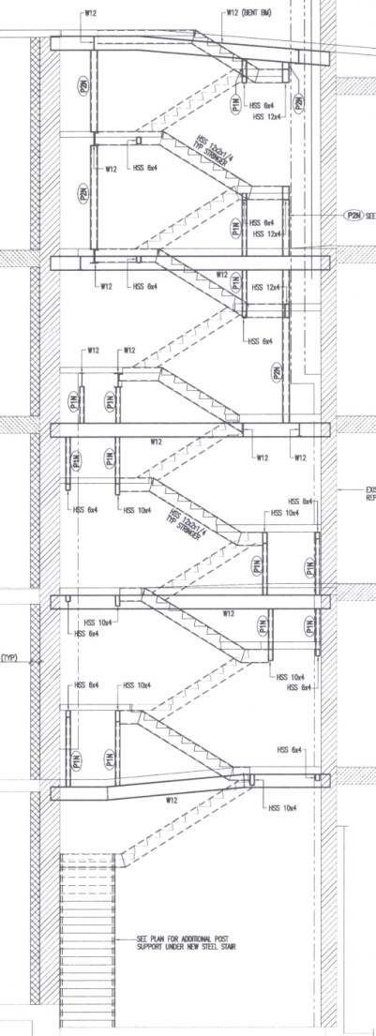
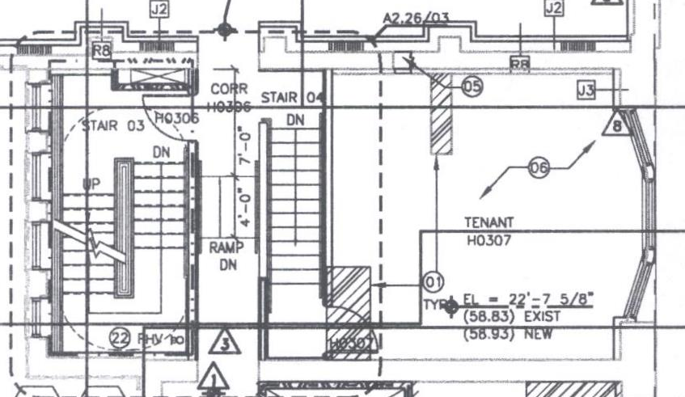
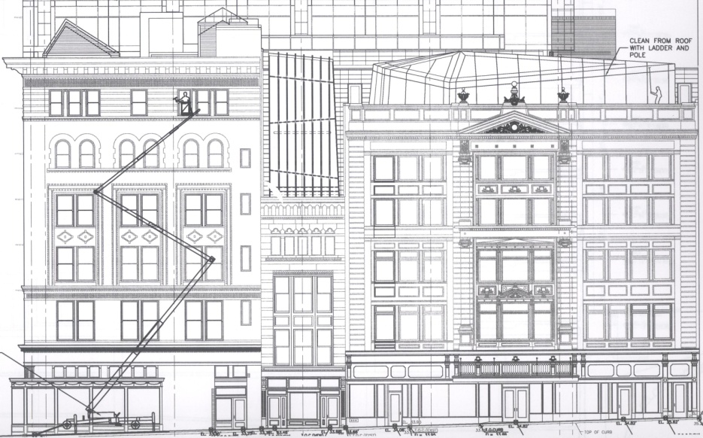
“Enabling Synergy Among Renovation Teams”
SQUARE 320 Project
Cohesion
3 Focus Areas
Cohesion
  Lack of Information, 3D Laser Surveying, Corcoran Stair
Innovation
  Basement Expansion, Financial Perspective, Value of Thinking Forward
  Recouping the Loss through Mechanical & Structural Redesign
Emotional Intelligence
  Poor Working Climate, EQ Assessment, Office vs Field Dynamic
Will It Work?
  Davis experts say NO!
  Concealed Conditions
  Tenants must keep working
  Technology not used at its full potential
Alternative Strategy
  Utilize 3D laser surveying in Corcoran stair well
  Design process took over a year
  All attention should’ve been placed there at the start.
Corcoran Stair
  Only Stair in Historic Renovations
  Varying landing elevations, risers
  Tight tolerance for glass work
  Goal: Vertical 3D scan
    => model to design from
Notes:
The Corcoran building is the narrow building sandwiched in between the BW to the left and the Nordlinger to the right. Since these three buildings all make up the retail space on the eastern side of the block, the buildings are interconnected and require only a single staircase to access each floor. The design placed these stairs in the back end of the Corcoran building because of its narrow width and central positioning in relationship to the other two buildings. The significant challenge associated with this design decision is that not all three buildings share the same elevation and as such not only do these stairs require custom layout and design but a series of ramps need to be installed transfer horizontally from floor to floor.
The plan view of the Corcoran stair clearly shows the retail space to the right with the staircase at the back of the building, as seen on the far left. The Corcoran building was so narrow that a standard size stairwell would not fit in the space. Still having to conform to ADA, the stair had to be specially designed with landing elevations required at non-repeating heights and number of risers per floor not being equal. All the while, the design of this stair demanded tight tolerance because of the architectural glass used along interior hand rails
This stair went through multiple redesigns before the final design was completed and eventually built. With as time-intensive as this design was, more detailed information would have significantly expedited the design process and done so by avoiding many of the frustrations and mistakes along the way. The ultimate goal and alternative to the original proposal would be to perform a 3D scan of the vertical space that would house the stair and then use that data to create a 3D model that the custom stair could be designed inside of. All the necessary information would be in the digital form and it could be quickly manipulated to ease the design process and eliminate conflicts that occurred when the original survey did not accurately show the existing conditions of the site. This 3D scan would be performed by simply traversing up the vertical space creating a scan at each landing and floor while hitting common targets that would allow the scans to be combined into a single point cloud. This alternative proposal would significantly decrease the design time down from the full year it required by traditional means.

Slide 22
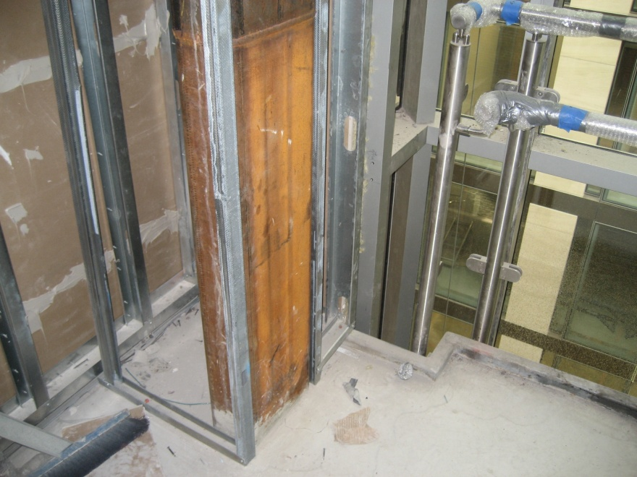
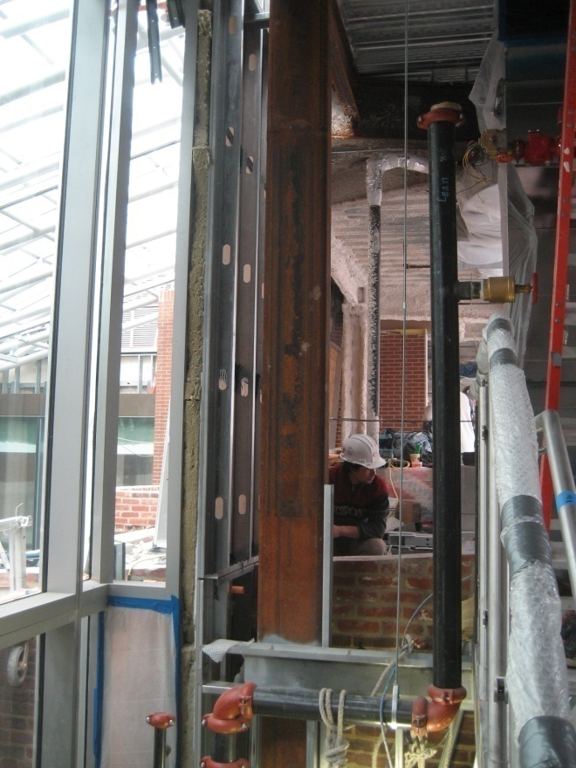
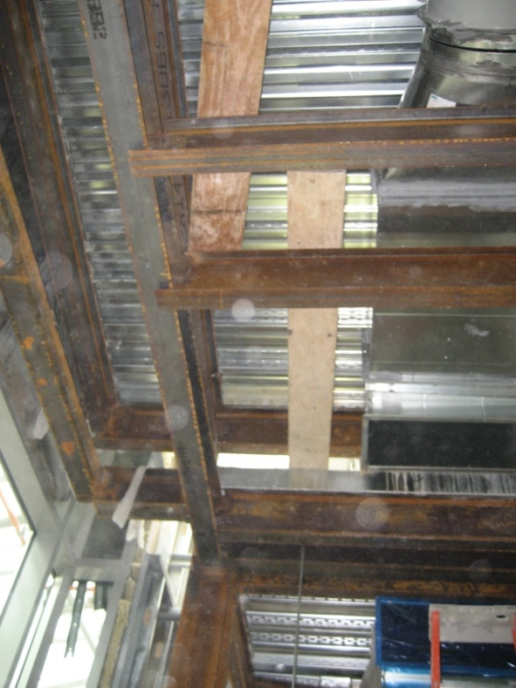
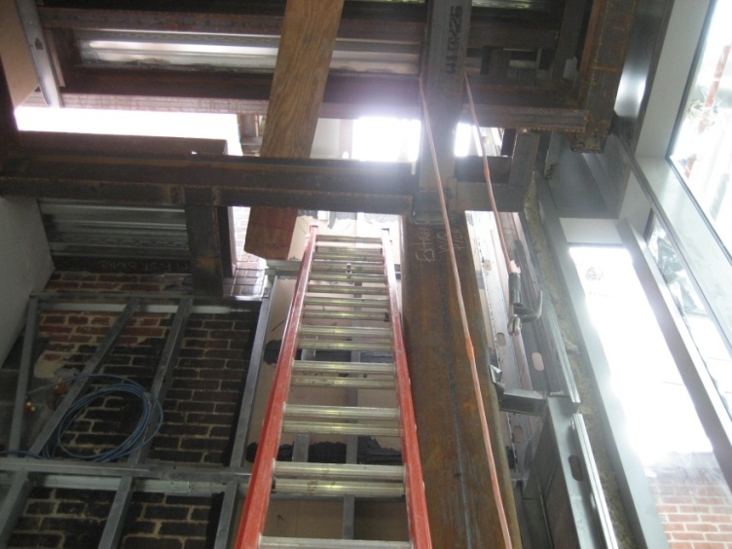
“Enabling Synergy Among Renovation Teams”
SQUARE 320 Project
Cohesion
3 Focus Areas
Cohesion
  Lack of Information, 3D Laser Surveying, Corcoran Stair
Innovation
  Basement Expansion, Financial Perspective, Value of Thinking Forward
  Recouping the Loss through Mechanical & Structural Redesign
Emotional Intelligence
  Poor Working Climate, EQ Assessment, Office vs Field Dynamic
Corcoran Stair
Avg Design Time = 16wks
Corcoran Stair > 52wks

Slide 23
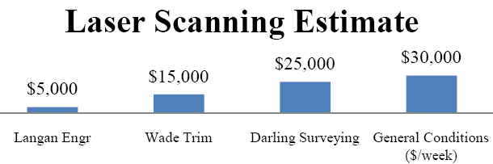
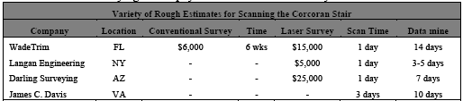
“Enabling Synergy Among Renovation Teams”
SQUARE 320 Project
Cohesion
3 Focus Areas
Cohesion
  Lack of Information, 3D Laser Surveying, Corcoran Stair
Innovation
  Basement Expansion, Financial Perspective, Value of Thinking Forward
  Recouping the Loss through Mechanical & Structural Redesign
Emotional Intelligence
  Poor Working Climate, EQ Assessment, Office vs Field Dynamic
Cost Comparison
  Time is cut to 1/3rd
  Avg Cost is 3x
  Design time cuts 4wks
  4 wks @ $30K = $120K
Notes:
The average scan could capture enough data in roughly 2 or 3 days. While the laser survey can cost as much as 4 times the price of a conventional survey, the detail is unbeatable and time it takes to manipulate that data into a 3D model still allows for an earlier finish than using traditional methods. If architects or engineers invest in the type of people that can work the specific software, then the surveyor would just need to capture the data for a day or two at a reasonable rate and deliver it to the designers. That whole design process just eliminated nearly 4 or 5 whole weeks. With a general conditions cost of approximately $30K per week, the added first cost of the laser surveying would pay for itself in a matter of days.

Slide 24
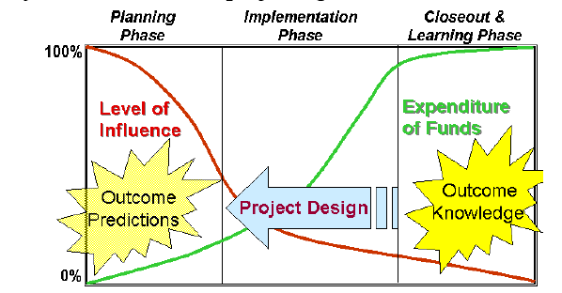
“Enabling Synergy Among Renovation Teams”
SQUARE 320 Project
Cohesion
3 Focus Areas
Cohesion
  Lack of Information, 3D Laser Surveying, Corcoran Stair
Innovation
  Basement Expansion, Financial Perspective, Value of Thinking Forward
  Recouping the Loss through Mechanical & Structural Redesign
Emotional Intelligence
  Poor Working Climate, EQ Assessment, Office vs Field Dynamic
Cost Comparison
  Time is cut to 1/3rd
  Avg Cost is 3x
  Design time cuts 4wks
  4 wks @ $30K = $120K
Cost-Savings Potential
  Kickoff meetings pre-design
  Early problem solving
  Early cohesive communication
  Surveyors are well-versed
  Coordination goes along way to save $
  Langan Engr Ex: 4000 conflicts avoided = $500,000 savings
Notes:
Experiencing Synergy Through The Information-Time-Money Relationship Based on his experiences, Rob Duranczyk of Wade Trim, admits that communication between disciplines is poor. Within the surveying field, those professionals know their lingo and understand their criteria. Part of the problem always seems to be the lack of communication and coordination that is done prior to the start of a project. If an owner were to schedule a kickoff meeting prior to the design stage all parties could be on the same page from the start. Teams could be introduced and as a unit they could discuss where they expect problems to arise from. This is where Rob believes the true cost savings lie; early communication has the most potential for financial gain. This is only further supported by the Cost Influence curve below that shows if the owner waits too late to encourage team work between the various parties involved, then their level of influence drastically diminishes as the projects gains momentum.
In the world of surveying, professionals get to be involved with designers as well as builders. In fact surveyors tend to be well-versed in all the difference disciplines involved on a construction project. The owner is ultimately their client but they‘re generally contracted with the CM. For surveyors, communication is key and a little coordination ahead of time can go a long way to save the owner money and expedite the project. If laser scanning can be implemented earlier, then the architects and the civil engineers can be working together sooner ensuring that both parties know the scope of the project and understand exactly what they need to accomplish at each stage in construction. By getting on the same page at first there are no longer assumptions that only one party understands. The technology takes the guesswork out of the job and allows the building‘s data to speak for itself. According to Langan Engineering, the real cost savings comes from having in house professionals that know how to interpret and handle the data that comes from the scanners. The cost of running the laser survey on site is considerably cheaper than the time and labor it takes to turn that information into a workable 3D design file. On one job, Langan built a BIM model directly from their 3D scans that helped virtually identify 3500 minor conflicts and 500 major conflicts on their project without ever stepping on site. All 4000 conflicts were able to be resolved in the virtual realm before the start of construction – each conflict was expected to require $7500 to resolve. Thanks to the implementation of 3D surveying on the project, the owner estimates that they saved over $500,000 from avoiding the onsite coordination struggles. The additional cost of using 3D scanning in lieu of traditional surveying easily paid for itself before the project even finished.

Slide 25
“Enabling Synergy Among Renovation Teams”
SQUARE 320 Project
Cohesion
3 Focus Areas
Cohesion
  Lack of Information, 3D Laser Surveying, Corcoran Stair
Innovation
  Basement Expansion, Financial Perspective, Value of Thinking Forward
  Recouping the Loss through Mechanical & Structural Redesign
Emotional Intelligence
  Poor Working Climate, EQ Assessment, Office vs Field Dynamic
Cost Comparison
  Time is cut to 1/3rd
  Avg Cost is 3x
  Design time cut 4wks
  4 wks @ $30K = $120K
Conclusion
  Information-Time-Money Relationship
    More efficient production rates
    Shorter design time required
    Fewer delays from RFIs
    Compressed schedule
      => Cost Savings: $120,000 – $425,000
Notes:
Conclusion
There is an inverse relationship between information and both time and money. The level of information any given team has on the project inversely equates to more efficient production rates and fewer delays from RFIs or hidden conditions. More efficient production rates relate directly to that portion of labor requiring less time for completion. If the job is completed faster, fewer resources need to be dedicated to the work and that aspect of the construction costs less as manpower and resources are used more efficiently. Therefore, had the initial surveying period implemented the use of 3D scanning technology, there would‘ve been much more information for the designers and the builders to work from. Without doubt, that increase in information would‘ve brought upon substantial time and money savings that would‘ve definitely benefited a project that suffered from endless setbacks.
In order to further optimize the situation, the owner should have engaged all parties at the earliest stage of this project to encourage proper communication, teamwork, and mutual support. As mentioned by Ryan Darling of Darling Surveying in Arizona, in order to utilize 3D mapping in all of its money savings capabilities, everyone must be on board from the beginning. Enabling multiple end-users to interface with the point-cloud early on will accelerate everyone‘s work and encourage teamwork from the start. It is evident, the frequent interaction and communication between all parties involved would have grown into a synergy, having every team take the initiative to expedite the work by encouraging quick and efficient communication at every step of the way. In this situation, each party would benefit from their mutual success leading to an outcome far greater for the whole than the sum of the individual successes reached on their own.

Slide 26
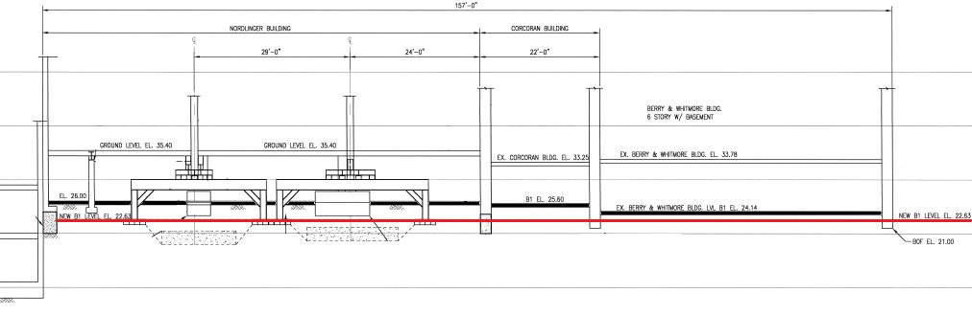
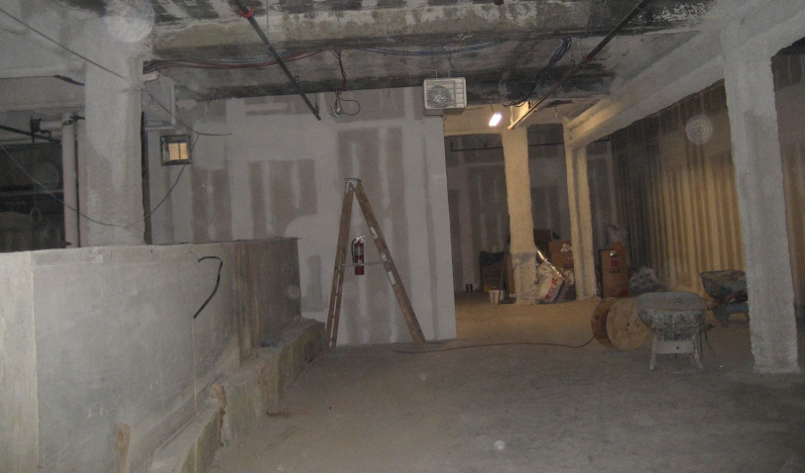
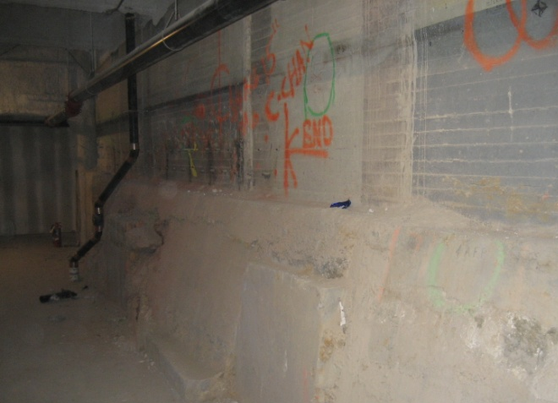
“Enabling Synergy Among Renovation Teams”
SQUARE 320 Project
Innovation
3 Focus Areas
Cohesion
  Lack of Information, 3D Laser Surveying, Corcoran Stair
Innovation
  Basement Expansion, Financial Perspective, Value of Thinking Forward
  Recouping the Loss through Mechanical & Structural Redesign
Emotional Intelligence
  Poor Working Climate, EQ Assessment, Office vs Field Dynamic
Problems
  Basement Expansion
    Purpose & Process
  Added Cost
  Schedule delays
  Little benefit
Basement Expansion
    Clark Foundation
    B1 Level – Lower Floor
    Created 2,300 rentable ft²
    4.25” Excavation
    Heavy Underpinning
    Systematically Jacked Each Column

Slide 27
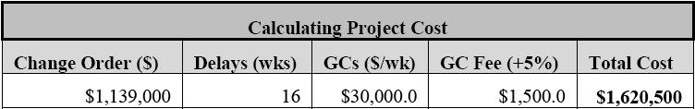
“Enabling Synergy Among Renovation Teams”
SQUARE 320 Project
Innovation
3 Focus Areas
Cohesion
  Lack of Information, 3D Laser Surveying, Corcoran Stair
Innovation
  Basement Expansion, Financial Perspective, Value of Thinking Forward
  Recouping the Loss through Mechanical & Structural Redesign
Emotional Intelligence
  Poor Working Climate, EQ Assessment, Office vs Field Dynamic
Financial Effects
$1M change order
4 months delay
Risk with dangerous procedures
Analysis
    CCIM financial Model
    Annual cash flow of $71,400
    23 yr payback
    IRR = 2.22% after taxes
Conclusion
  Not the lucrative decision
    Little gain with severe financial penalty
    Space will likely sell for below avg rate – not desirable space
    Only represents 1.5-2% total office space
  Would’ve saved:
    $1.6M (2.6% project cost) & 4 months
      => Cut Your Losses

Slide 28
“Enabling Synergy Among Renovation Teams”
SQUARE 320 Project
Innovation
3 Focus Areas
Cohesion
  Lack of Information, 3D Laser Surveying, Corcoran Stair
Innovation
  Basement Expansion, Financial Perspective, Value of Thinking Forward
  Recouping the Loss through Mechanical & Structural Redesign
Emotional Intelligence
  Poor Working Climate, EQ Assessment, Office vs Field Dynamic
Innovation’s Role
Thinking forward would’ve prevented the loss
Alternative ways to recoup the $1.6M
  Economic redesign of the structural Jacking system
  Pursuit of alternative Mechanical system

Slide 29
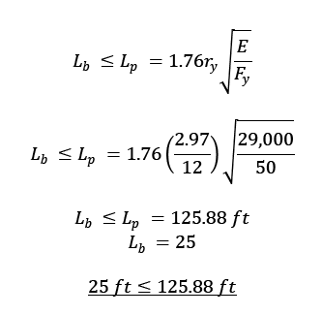
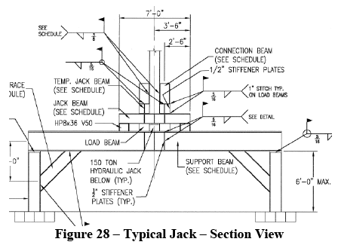
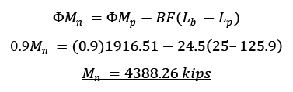

“Enabling Synergy Among Renovation Teams”
SQUARE 320 Project
Innovation
3 Focus Areas
Cohesion
  Lack of Information, 3D Laser Surveying, Corcoran Stair
Innovation
  Basement Expansion, Financial Perspective, Value of Thinking Forward
  Recouping the Loss through Mechanical & Structural Redesign
Emotional Intelligence
  Poor Working Climate, EQ Assessment, Office vs Field Dynamic
Innovation’s Role
Thinking forward would’ve prevented the loss
Alternative ways to recoup the $1.6M
  Economic redesign of the structural Jacking system
  Pursuit of alternative Mechanical system
Designed based on
  Maximum moment
  Deflection
  Checked for lateral torsional buckling
  Critical bending moment
  Critical buckling load

Slide 30
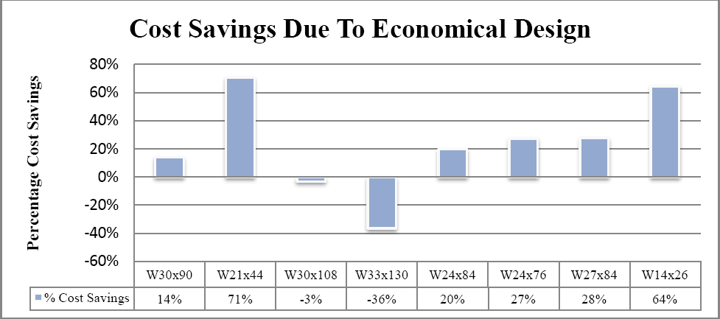
“Enabling Synergy Among Renovation Teams”
SQUARE 320 Project
Innovation
3 Focus Areas
Cohesion
  Lack of Information, 3D Laser Surveying, Corcoran Stair
Innovation
  Basement Expansion, Financial Perspective, Value of Thinking Forward
  Recouping the Loss through Mechanical & Structural Redesign
Emotional Intelligence
  Poor Working Climate, EQ Assessment, Office vs Field Dynamic
Innovation’s Role
Thinking forward would’ve prevented the loss
Alternative ways to recoup the $1.6M
  Economic redesign of the structural Jacking system
  Pursuit of alternative Mechanical system
Structural Jacking System Redesign
  No substantial financial gain
  Only 2 alternative members provide real cost savings

Slide 31
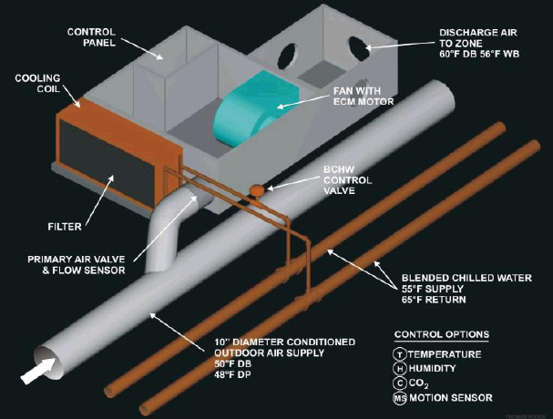
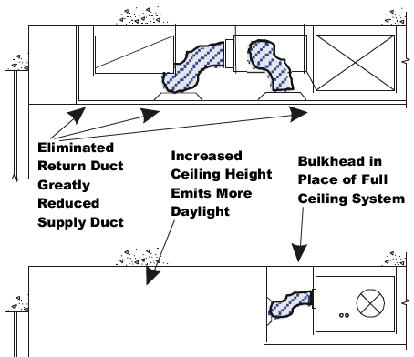
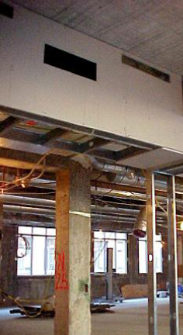
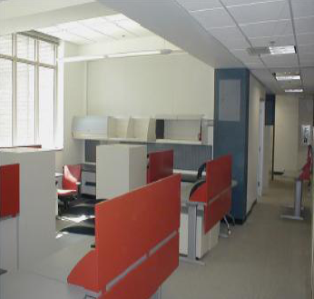
“Enabling Synergy Among Renovation Teams”
SQUARE 320 Project
Innovation
3 Focus Areas
Cohesion
  Lack of Information, 3D Laser Surveying, Corcoran Stair
Innovation
  Basement Expansion, Financial Perspective, Value of Thinking Forward
  Recouping the Loss through Mechanical & Structural Redesign
Emotional Intelligence
  Poor Working Climate, EQ Assessment, Office vs Field Dynamic
Alternative Mechanical System
Benefits of Fan-Powered Induction Units (FPIU):
  Increased energy efficiency
  Superior indoor air quality (IAQ)
  Increased air circulation & ventilation
  No RA duct required or VAV units
  Higher ceilings & Day lighting
  No need for Mech room per floor
  Significantly downsize AHU
  Local mfrs, interchangeable parts
  Control noise w/ high velocity SA
Notes:
Within the recent years, Southland Industries, located in the Northern Virginia area, designed a brand new type of mechanical system. The Fan-Powered Induction Units (FPIU) consists of two boxes, one large and one small. The large box acts as the mixing zone where the indoor air meets the outdoor supply air after being filtered and passed through the cooling coil. The mixed air in the large box is then drawn into the small box where it is discharged back into the space via the ECM motor.
The beauty of this system is that all of the conditioning and mixing happens on the spot, not in the mechanical space a significant distance away. In addition, there is no need for return air duct because the indoor air is circulated locally with the outdoor air that is supplied to each unit. Due to the location of the cooling coil in each unit, there needs to be supply and return chilled water as well as hot water. This is an added cost but it is quickly outweighed in comparison to the cost savings associated with not requiring return duct. Additionally, this design no longer requires a V-VAV unit on each floor and due to a significant decrease in load, there root-top AHU gets significantly smaller.
The FPIU represents a considerable first-cost savings because so much of the previously designed equipment is no longer required. There is an additional energy usage due to the constant use of the ECM motor but by utilizing an enthalpy wheel, the energy is recycled and the potential for increased energy usage becomes a ‗wash‘. Designing with the FPIU system is extremely flexible, because the only requirement is that a box is located to serve an area of space between 400 to 800ft2. Additionally, this system is great for a Tenant-Fit-Out (TFO) because they can design to number and location of the units to precisely the needed amount. The plan view below displays how these FPIUs are generally arranged in a long column.
Due the lack of return duct, there is a significant volume of ceiling plenum space that can be recaptured for architectural design. Each unit measures 30‖ wide, roughly 5ft long, but only hangs down 18‖ from the ceiling. With the creation of a vertical bulkhead along the outside edge of the units, the air can be supplied into the room without requiring row of ductwork. Fig 24 below shows the plenum diagram for the as-built VAV traditional system. The whole mechanical design revolved around the necessity to create the largest ceiling height as possible, which resulted in being 9 ft high.
In comparing the two diagrams, the former requires a 9ft ceiling height throughout the entire floor to provide space for the comprehensive duct work and lighting systems. The latter clearly shows that the majority of the plenum space can be recaptured an opened up to allow an additional 18-24‖ of ceiling height in the regions void of an FPIU unit. All of the plenum space that was being used to house duct work in the original design can be opened up to provide higher ceiling heights, added day lighting, and a more pleasing architectural ambiance. In the images below, this bulkhead can be seen running in a column down the center of this building‘s wing. On either side of the bulkhead the ceiling height is raised providing the feeling of more open space coupled with additional daylighting.
Benefits While the original VAV design satisfies the demands of the project, it provides Square 320 with little benefit in the long run in terms of energy savings over time. Additionally, the move to away from the V-VAV units equates into a significant first-cost reduction as well. The FPIU units offer a wealth of added benefits without any real negatives for the project. From the construction management perspective there is significant cost savings in equipment & duct, energy savings with better performance, simplified coordination of the plenum space between different trades, and higher ceilings with added day lighting just to name a few. In addition, from the mechanical perspective, this system provides high velocity supply air with high Indoor Air Quality, increased ventilation effectiveness, and all the manufactures are local and easily interchangeable. There is good reason to believe that making the design switch from the traditional VAV system to Southland Industries‘ FPIU units greatly benefit the Square 320 project and potentially provide an opportunity to recapture a portion of the $1.6M added cost that resulted from the basement expansion.

Slide 32
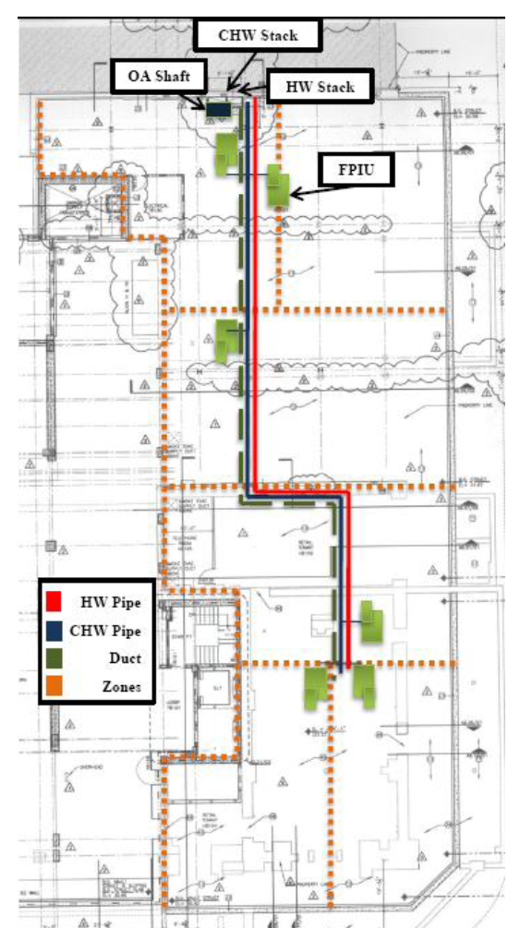
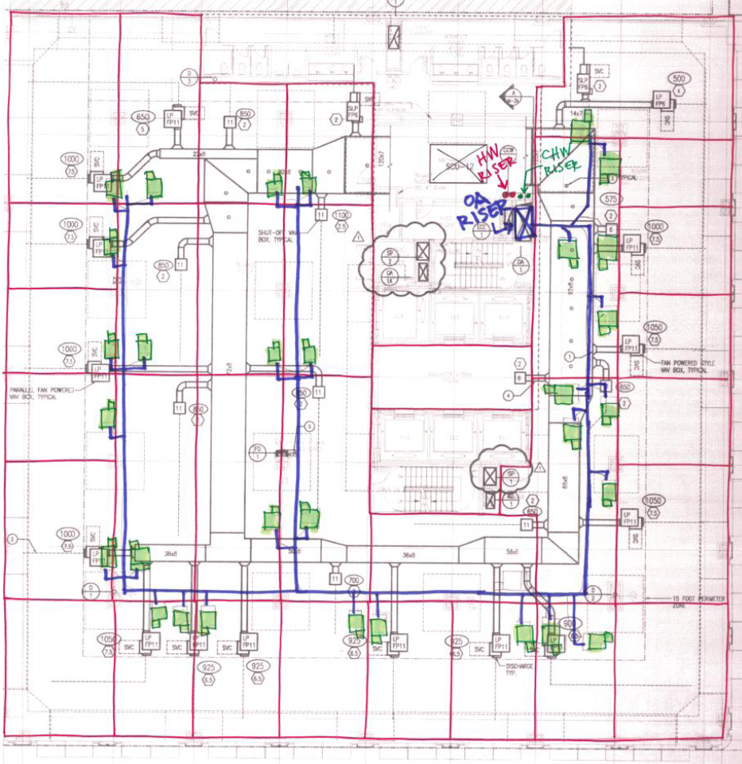
“Enabling Synergy Among Renovation Teams”
SQUARE 320 Project
Innovation
3 Focus Areas
Cohesion
  Lack of Information, 3D Laser Surveying, Corcoran Stair
Innovation
  Basement Expansion, Financial Perspective, Value of Thinking Forward
  Recouping the Loss through Mechanical & Structural Redesign
Emotional Intelligence
  Poor Working Climate, EQ Assessment, Office vs Field Dynamic
Historic Schematic Design
Determine # units based ft²
  Add SA duct
  Add CHW & HW Pipe
  Requires 6 FPIUs
Tower Schematic Design
Determine # units based ft²
  Add SA duct
  Add CHW & HW Pipe
  Requires 31 FPIUs
  Notice: closed loop SA from
  original design

Slide 33
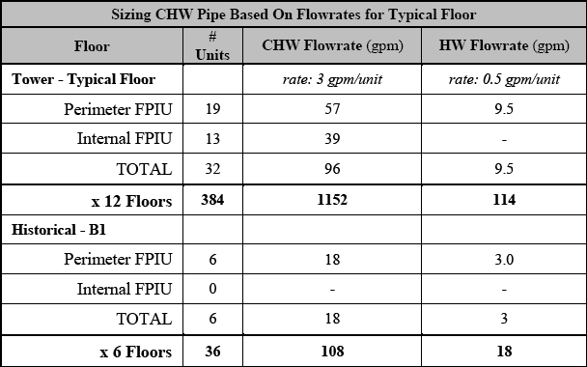
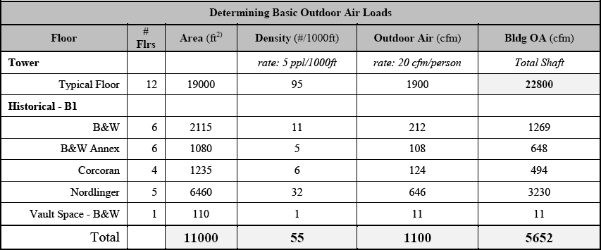
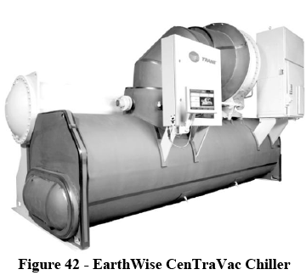
“Enabling Synergy Among Renovation Teams”
SQUARE 320 Project
Innovation
3 Focus Areas
Cohesion
  Lack of Information, 3D Laser Surveying, Corcoran Stair
Innovation
  Basement Expansion, Financial Perspective, Value of Thinking Forward
  Recouping the Loss through Mechanical & Structural Redesign
Emotional Intelligence
  Poor Working Climate, EQ Assessment, Office vs Field Dynamic
Determine OA Loads
Benefits of Fan-Powered Induction Units (FPIU):
  Table 6.1 ASHRAE – Min Vent Rates By Density
  Determined OA Load for each building
  Sized shaft & ductwork
Determined Water Loads
Size CHW pipe & HW pipe
  Determined Load to size Chiller
  Sized the boiler as well

Slide 34
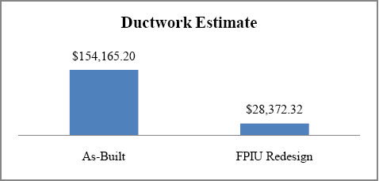
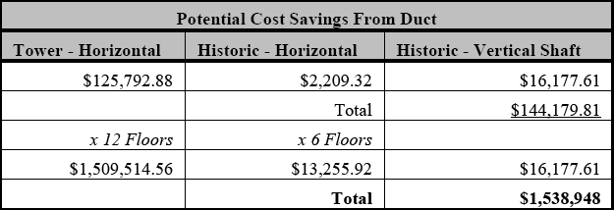
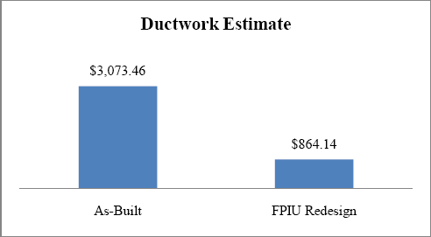
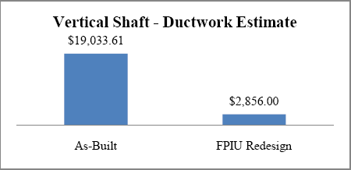
“Enabling Synergy Among Renovation Teams”
SQUARE 320 Project
Innovation
3 Focus Areas
Cohesion
  Lack of Information, 3D Laser Surveying, Corcoran Stair
Innovation
  Basement Expansion, Financial Perspective, Value of Thinking Forward
  Recouping the Loss through Mechanical & Structural Redesign
Emotional Intelligence
  Poor Working Climate, EQ Assessment, Office vs Field Dynamic
Duct Work Estimate
Performed traditional takeoffs
Used DuctCalc software for estimates
Tower
  Supply duct savings=> $125000 / 82%
Historic
  Supply duct savings=> $2210 / 73%
Historical Shaft
  Supply duct savings=> $16177 / 85%
Tower
Total Savings For Project
Savings multiplied by floors
  Total Savings = $1.5M
  Excludes cost of added pipe
Historic
Historic
Nearly Covers The Cost Of Basement Expansion
Notes:
Conclusions
There are many benefits to this type of system, many of which have already been covered. But specifically with the redesign of the Tower and Historical floors, the FPIU can give back a considerable amount of the lost plenum space taken up by the previous design. Higher ceilings are especially important in the Washington, DC area where building heights are strictly monitored but having more ceiling to floor height is a considerable architectural advantage for to the tenants; there‘s even a good chance that the owner might charge a premium for the office space, especially when it feels spacious. Additional opportunities for cost savings in regards to this specific project would be with the elimination of 12 SCUs where one is on each of the tower floors. Those big pieces of equipment are no longer necessary because all of the air-mixing, heating, and cooling occurs inside each of the FPIUs. This will save you the first cost of the equipment, paying the utilities to run it, and last but not least, you will get back some additional rentable space on each level. More floor space means more income for the owner. In terms of the as-built mechanical design, more in-depth research was done looking into the design of the ductwork alone, and there were considerable concerns that many industry professionals mentioned in terms of the ductwork design. The sizing and design of the ductwork doesn‘t seem like it will work very well. This is due to the bizarre series of ductwork aspect ratios (duct width divided by duct depth) that are absolutely awful. For example, with 92x8 duct, the aspect ratio is 11.5:1. For 72x8 it‘s 9:1. And for 50x8, it‘s 6:1. The general rule of thumb, as passed on to me from industry professionals, is the ideal aspect ratio is 1:1. For this reason, Southland uses round duct in these situations as their standard. This is also partially due to the fact that round duct is easier to install in the field, too. The max aspect ratio one should ever use is 4:1. As the estimates and typical floor plans show, a lot of the big duct mains are a lot worse than that. The goal of the original design was obviously to use as little depth as possible, but in turn their design greatly affects airflow for the worse. It restricts it first of all, and it will probably end up ―starving‖ the boxes since there‘s a good chance they won‘t get enough air flow at all. Additionally, with duct sizes as large as 120x7, the entire coordination process becomes extremely challenging when you are trying to install conduit, lighting, data cables but you can‘t because you can barely work behind the 10ft wide duct. While I‘m not the expert, I know enough to say the as-built duct design is really poor. The FPIU system only requires a single line of ductwork, open air, and as noted above, the ductwork from the design is no bigger than 12‖x12‖. For that reason and the many that precede it, the FPIU system is the best alternative for a poorly designed VAV system.

Slide 35



“Enabling Synergy Among Renovation Teams”
SQUARE 320 Project
Emotional Intelligence
3 Focus Areas
Cohesion
  Lack of Information, 3D Laser Surveying, Corcoran Stair
Innovation
  Basement Expansion, Financial Perspective, Value of Thinking Forward
  Recouping the Loss through Mechanical & Structural Redesign
Emotional Intelligence
  Poor Working Climate, EQ Assessment, Office vs Field Dynamic
Problem
Poor working climate
Constant frustration
High relationships
Conflicting personalities
Notes:
Why is emotional intelligence especially poignant in the construction industry? In a technical industry like construction, workers and managers alike will not always be able to understand or even articulate all the inherent details and specifics of the job. This is where teamwork and healthy communication are vital to the success of the project. If members of the team were to have significant challenges with deficiencies in specific EQ areas, this would become evident in their communication and would hinder their progress. As Brent Darnell says in his book, The People-Profit Connection, the people who excel are the ones with higher levels of emotional intelligence. Technical skills are referred to as the ‗price of entry‘ but emotional intelligence is vital for ongoing success. In a similar way, the EQ assessment, if taken by an entire team, can brings to light the current conditions of a project like the working relationships or the current challenges and issues the project is facing. It is for this reason especially, that EQ can be a very effective managing tool in the industry and on the job site. Some of the challenges with working relationships on a jobsite are not easily noticed at first and potentially can lead to significant delays with financial implications. The power of the EQ assessments come to play in that a routine retesting of a construction team and can first gauge the condition of the relationships and second the progress of those individuals to strengthen the relationships. In this way, the EQ assessment can become a monitoring tool keeping a figure on the ‗pulse‘ of a project based on what kinds of feedback the tests are providing. Based on the research of C.J. Butler, P.S. Chinowsky, and R.Y. Sunindijo, construction industry professionals with higher EQ scores tend to be better communicators, more proactive leaders, and stronger delegators. These are very valuable traits that help to drive the progress of a construction project. If intentionally monitored and developed, possessing these traits brings upon
Slide Right
With this typical profile, most CMs are interpreted to be aggressive and independent to the extreme where they no longer ask for help, listen to others‘ input, or involve people in the decision making. Additionally, without the interpersonal skills to counteract their aggressive and assertive nature, these strengths can quickly counteract their progress and hinder their success. The goal for anyone is to have a balance across the board without a lot of relative differences that stick out among the rest.

Slide 36


“Enabling Synergy Among Renovation Teams”
SQUARE 320 Project
Emotional Intelligence
3 Focus Areas
Cohesion
  Lack of Information, 3D Laser Surveying, Corcoran Stair
Innovation
  Basement Expansion, Financial Perspective, Value of Thinking Forward
  Recouping the Loss through Mechanical & Structural Redesign
Emotional Intelligence
  Poor Working Climate, EQ Assessment, Office vs Field Dynamic
Emotional Intelligence is the capacity to recognize one‘s feelings and those of others, for motivating ourselves, and managing our own emotions and emotions within our relationships.
High
Assertiveness
Self-Regard
Independence
Low
Emotional
Self-awareness
-
Empathy
Social Responsibility
Interpersonal
Relationship Skills
Chaos
High Stress Tol. vs
Low Impulse Contr.
Core Competencies
Courtesy of Brent Darnell
Notes:
Why is emotional intelligence especially poignant in the construction industry? In a technical industry like construction, workers and managers alike will not always be able to understand or even articulate all the inherent details and specifics of the job. This is where teamwork and healthy communication are vital to the success of the project. If members of the team were to have significant challenges with deficiencies in specific EQ areas, this would become evident in their communication and would hinder their progress. As Brent Darnell says in his book, The People-Profit Connection, the people who excel are the ones with higher levels of emotional intelligence. Technical skills are referred to as the ‗price of entry‘ but emotional intelligence is vital for ongoing success. In a similar way, the EQ assessment, if taken by an entire team, can brings to light the current conditions of a project like the working relationships or the current challenges and issues the project is facing. It is for this reason especially, that EQ can be a very effective managing tool in the industry and on the job site. Some of the challenges with working relationships on a jobsite are not easily noticed at first and potentially can lead to significant delays with financial implications. The power of the EQ assessments come to play in that a routine retesting of a construction team and can first gauge the condition of the relationships and second the progress of those individuals to strengthen the relationships. In this way, the EQ assessment can become a monitoring tool keeping a figure on the ‗pulse‘ of a project based on what kinds of feedback the tests are providing. Based on the research of C.J. Butler, P.S. Chinowsky, and R.Y. Sunindijo, construction industry professionals with higher EQ scores tend to be better communicators, more proactive leaders, and stronger delegators. These are very valuable traits that help to drive the progress of a construction project. If intentionally monitored and developed, possessing these traits brings upon
Slide Right
With this typical profile, most CMs are interpreted to be aggressive and independent to the extreme where they no longer ask for help, listen to others‘ input, or involve people in the decision making. Additionally, without the interpersonal skills to counteract their aggressive and assertive nature, these strengths can quickly counteract their progress and hinder their success. The goal for anyone is to have a balance across the board without a lot of relative differences that stick out among the rest.

Slide 37


“Enabling Synergy Among Renovation Teams”
SQUARE 320 Project
Emotional Intelligence
3 Focus Areas
Cohesion
  Lack of Information, 3D Laser Surveying, Corcoran Stair
Innovation
  Basement Expansion, Financial Perspective, Value of Thinking Forward
  Recouping the Loss through Mechanical & Structural Redesign
Emotional Intelligence
  Poor Working Climate, EQ Assessment, Office vs Field Dynamic
Organizational Structure
Visual Feedback
Very similar to standard CM profile
Low
Emotional Self-Awareness
Stress Tolerance
Happiness

Slide 38


“Enabling Synergy Among Renovation Teams”
SQUARE 320 Project
Emotional Intelligence
3 Focus Areas
Cohesion
  Lack of Information, 3D Laser Surveying, Corcoran Stair
Innovation
  Basement Expansion, Financial Perspective, Value of Thinking Forward
  Recouping the Loss through Mechanical & Structural Redesign
Emotional Intelligence
  Poor Working Climate, EQ Assessment, Office vs Field Dynamic
Organizational Structure
Visual Feedback
Similar to standard CM profile
High
Emotional Self-Awareness
Problem Solving
Happiness

Slide 39

“Enabling Synergy Among Renovation Teams”
SQUARE 320 Project
Emotional Intelligence
Observations
Field vs. Office Dynamic
3 Focus Areas
Cohesion
  Lack of Information, 3D Laser Surveying, Corcoran Stair
Innovation
  Basement Expansion, Financial Perspective, Value of Thinking Forward
  Recouping the Loss through Mechanical & Structural Redesign
Emotional Intelligence
  Poor Working Climate, EQ Assessment, Office vs Field Dynamic
NOTE: Not statistically verifiable, absolute values
Low stress tolerance & impulse control
+ low optimism & self-actualization
=> Burnout profile
High self-regard, independence & self-awareness,
+ low empathy & interpersonal relationship skills
=> Dysfunctional relationships
Office Team
Empathy, self-awareness, and happiness scores are considerably lower than the field
=> Poor relationship skills
=> Strained, frustrated and tired
Low stress tolerance but Field has higher optimistic & self-aware
=> Handle stress better
EQ is a snapshot of the present,
Reflection of the current project climate
Strained working relationships contrasted w/ proud workers
=> Industry expects projects to be hard and troublesome
Office bogged down with comms/relationship problems the project faces + near completion
=> Feel burnt out
Field feels like ‘thrown to the wolves’,
challenging proj with limtd info and bad comms
Notes:
Summary of Findings Overall, based on the written response portion of the surveys, the first obvious side-effect from the Square 320 project is the existence of strained working relationships contrasted with the concurring feeling that all parties were very proud of their work and of the project. That speaks a lot about the industry, that individuals expect projects to be hard and troublesome even though working on construction projects doesn‘t have to be.
What tends to be most interesting is that as a group, the combination of the low stress tolerance, low impulse control, with the lower optimism and lower self-actualization clearly shows the burnout profile. The results indicate that the people involved on this project are tired and worn-out with only a slight difference between the field and office teams, being that those on site show a relatively higher sense of self-actualization and optimism than the other team. Now, one must keep in mind that this remains a simple evaluation. Only a small sampling of 8 people was surveyed and as a result the data cannot possibly be statistically verifiable. Additionally, the survey is not as in-depth as the 130+ Bar-On EQ-I survey used in most research. However, there is still value in the relative differences that the results display, even though they are not absolute numbers.
What‘s most important is that the relative values show the individual what they should pay attention and where they have room to develop. High self-regard, independence, and self-awareness, when combined with lower empathy and interpersonal relationship skills tends to be a recipe disaster. While the results are just a relative distance on the 1-15 scale, the general overview stands that same, that as a team, these professionals are not very strong in their relationship skills. This can be especially seen with the office team where their average empathy, self-awareness, and happiness scores are considerably lower than those of the field team. It is evident in the scores that the office team is strained, frustrated and tired. This is very typical of the Construction Management community in many ways. It is also worth mentioning that the more senior members, at least with the office team, tend to have much more balanced profiles. As discussed earlier from The People-Profit Connection, as professionals gain more experience and mature in the industry, their EQ profile gets stronger with age, especially in the weaker areas. Unlike other testing whether it is IQ or Myers-Brigs, the EQ test is a reflection of the present time. It is a reflection of the project at the moment the survey is taken and the results of each individual can potentially be swayed significantly in many ways. For example, if an individual was currently working on a part of the project that required the help of a few people and the supervision of one, this person would show a very low score for independence. That same person, if put on a smaller task alone, would see their independence score take a significant jump up. As a result, by collecting the data and interpreting the results, we tend to get a very honest look into the general mood and attitude of the project at that moment in time. Furthermore, the other varying aspect is what is going on outside of the work in the lives of each of the individuals. There‘s no possible way to know that for sure but one can surmise and there‘s always room for conjecture. It appears as though the field is in a better position for success and enjoyment on this project. It‘s difficult to place exactly why but perhaps the field individuals just feel as though they can handle the pressures better. Both groups have low stress tolerance but those in the field appear more optimistic and more self-aware of themselves so they know better how to deal with the stress. Perhaps the office guys are just too bogged down with handling the communication and relationship problems the project faces and now that they are a couple months away from completion they are just burnt out. Additionally, to some extent the field team might feel like they‘ve been ‗thrown to the wolves‘, forced into a challenging project with limited information and bad communication.

Slide 40
“Enabling Synergy Among Renovation Teams”
SQUARE 320 Project
Emotional Intelligence
Observations
Field vs. Office Dynamic
Recommendations
3 Focus Areas
Cohesion
  Lack of Information, 3D Laser Surveying, Corcoran Stair
Innovation
  Basement Expansion, Financial Perspective, Value of Thinking Forward
  Recouping the Loss through Mechanical & Structural Redesign
Emotional Intelligence
  Poor Working Climate, EQ Assessment, Office vs Field Dynamic
NOTE: Not statistically verifiable, absolute values
Low stress tolerance & impulse control
+ low optimism & self-actualization
=> Burnout profile
High self-regard, independence & self-awareness,
+ low empathy & interpersonal relationship skills
=> Dysfunctional relationships
Office Team
Empathy, self-awareness, and happiness scores are considerably lower than the field
=> Poor relationship skills
=> Strained, frustrated and tired
Low stress tolerance but Field has higher optimistic & self-aware
=> Handle stress better
EQ is a snapshot of the present,
Reflection of the current project climate
Strained working relationships contrasted w/ proud workers
=> Industry expects projects to be hard and troublesome
Office bogged down with comms/relationship problems the project faces + near completion
=> Feel burnt out
Field feels like ‘thrown to the wolves’,
challenging proj with limtd info and bad comms
Surveys & Interview confirm the accuracy of EQ assessment
  Individuals opportunity to self-monitor their development
  monitor working relationships &interactions on the job
Significant potential for gain through periodic monitoring of EQ assessments
  Improve working conditions, relationships, refocus energies
Progress Reports: Tasks <=> EQ: Team Synergy
Synergy
= individual collaboration forms a team, accountable to work w/ vested interest in project success
Notes:
Recommendations
From the interviews and discussion above, it is evident that there is a lot of value in the accuracy of an EQ assessment, both in providing individuals the opportunity to self-monitor their development, as well as monitoring the working relationships and interactions on the job at that point in time. Many professionals use the EQ-I testing as an annual evaluation of their growth and maturation. What this report shows and what the research proposes, is that there is significant potential for gain in terms of striving to better the working conditions on site through the periodic monitoring of EQ assessments. In the same way that progress reports give a snapshot of how much work has been completed, the EQ can monitors the health of the team and the degree to which the various parts of the ‗body‘ are working as a whole. In essence, there is significant potential for a project‘s growth and potential for success when a team can reach a level of synergy. This synergy refers to the combined effort of individuals as participants of the team when their collaboration produces results that are greater than the sum of their parts. This can be accomplished but only when intentional efforts are made to hold every member of the team accountable to their work and the vested interest in they have in the success of the project.

Slide 41
“Enabling Synergy Among Renovation Teams”
SQUARE 320 Project
Summary
My Proposal
Remove Tenants Earlier – Demolish Interior – 3D Laser Scan
  Hold Kickoff Meetings Prior to Design Stage (Owner, A/E, CM, Civil)
  Avoid Basement Expansion – Utilize Space for Mech/Elec & Storage
Replace VAV System w/ FPIUs
  Quarterly EQ Assessments for Key Players: CM Field & Office, Arch, Lead Contractors
      Effective Collaboration, Schedule Acceleration,
  Cost Savings, Individual & Organizational Growth

Slide 42
“Enabling Synergy Among Renovation Teams”
SQUARE 320 Project
Summary
“Enabling Synergy Among Renovation Teams”
Cohesion
More Information Early + Enhanced Communication => Efficient & Better Quality Work
3D Laser Surveying (Info) + Key Player Kickoff Meetings => Teamwork & Unity
Innovation
Need Cohesive Teams to be Forward Thinking
Utilize Alternative Technologies & Redesigned Systems Wherever Sensible
=> Avoid Design Decisions Resulting in Severe Financial Penalties
=> Pursue Potential Savings for Each Party
Emotional Intelligence
Periodic Monitoring = Insight into Individuals & Project Climate Simultaneously
Allows Focused Efforts to Develop Individual & Project
Encourages Tailoring Project Climate to Highlight Teams Strengths
…Ultimately, enabling synergy among renovation teams
My Proposal
Remove Tenants Earlier – Demolish Interior – 3D Laser Scan
  Hold Kickoff Meetings Prior to Design Stage (Owner, A/E, CM, Civil)
  Avoid Basement Expansion – Utilize Space for Mech/Elec & Storage
Replace VAV System w/ FPIUs
  Quarterly EQ Assessments for Key Players: CM Field & Office, Arch, Lead Contractors
      Effective Collaboration, Schedule Acceleration,
  Cost Savings, Individual & Organizational Growth

Slide 43
“Enabling Synergy Among Renovation Teams”
SQUARE 320 Project
Closing
“Enabling Synergy Among Renovation Teams”
Thank You
Pennsylvania State University
Dept of Architectural Engineering
To whom made it all possible:
Jonathan Dougherty
Tyler Moyer, Bill Moyer, Keith Foote
Nate & Julie Patrick,
Brent Darnell
Professors: D. Riley, M. Horman,
L. Geschwindner. R. Holland
James C. Davis Construction Corp., Southland Industries, WadeTrim, Langan Engineering, Berding Surveying, Darling Environmental & Surveying
Mom & Dad
ShAdy psU Family
Cohesion
More Information Early + Enhanced Communication => Efficient & Better Quality Work
3D Laser Surveying (Info) + Key Player Kickoff Meetings => Teamwork & Unity
Innovation
Need Cohesive Teams to be Forward Thinking
Utilize Alternative Technologies & Redesigned Systems Wherever Sensible
=> Avoid Design Decisions Resulting in Severe Financial Penalties
=> Pursue Potential Savings for Each Party
Emotional Intelligence
Periodic Monitoring = Insight into Individuals & Project Climate Simultaneously
Allows Focused Efforts to Develop Individual & Project
Encourages Tailoring Project Climate to Highlight Teams Strengths
…Ultimately, enabling synergy among renovation teams
My Proposal
Remove Tenants Earlier – Demolish Interior – 3D Laser Scan
  Hold Kickoff Meetings Prior to Design Stage (Owner, A/E, CM, Civil)
  Avoid Basement Expansion – Utilize Space for Mech/Elec & Storage
Replace VAV System w/ FPIUs
  Quarterly EQ Assessments for Key Players: CM Field & Office, Arch, Lead Contractors
      Effective Collaboration, Schedule Acceleration,
  Cost Savings, Individual & Organizational Growth

Slide 44


“Enabling Synergy Among Renovation Teams”
SQUARE 320 Project
Questions
“Enabling Synergy Among Renovation Teams”
Cohesion
More Information Early + Enhanced Communication => Efficient & Better Quality Work
3D Laser Surveying (Info) + Key Player Kickoff Meetings => Teamwork & Unity
Innovation
Need Cohesive Teams to be Forward Thinking
Utilize Alternative Technologies & Redesigned Systems Wherever Sensible
=> Avoid Design Decisions Resulting in Severe Financial Penalties
=> Pursue Potential Savings for Each Party
Emotional Intelligence
Periodic Monitoring = Insight into Individuals & Project Climate Simultaneously
Allows Focused Efforts to Develop Individual & Project
Encourages Tailoring Project Climate to Highlight Teams Strengths
…Ultimately, enabling synergy among renovation teams
My Proposal
Remove Tenants Earlier – Demolish Interior – 3D Laser Scan
  Hold Kickoff Meetings Prior to Design Stage (Owner, A/E, CM, Civil)
  Avoid Basement Expansion – Utilize Space for Mech/Elec & Storage
Replace VAV System w/ FPIUs
  Quarterly EQ Assessments for Key Players: CM Field & Office, Arch, Lead Contractors
      Effective Collaboration, Schedule Acceleration,
  Cost Savings, Individual & Organizational Growth
Questions?

Slide 46



“Enabling Synergy Among Renovation Teams”
SQUARE 320 Project
Images

Slide 47


“Enabling Synergy Among Renovation Teams”
SQUARE 320 Project
Images

Slide 48



“Enabling Synergy Among Renovation Teams”
SQUARE 320 Project
Images

Slide 49


“Enabling Synergy Among Renovation Teams”
Building Intrigue
Exciting Aspects
  Project Overview
    Project details, Owner’s Role w/ DAVIS, Project Intrigue
  Information-Time-Money Relationship
    3D Laser Scanning, Corcoran Stair, Money Saving Power
  Hindsight Perspective of the Basement Expansion
    Added Cost, Schedule Delays, Potential Earnings Growth,
    Recovering That Loss
  Emotional Intelligence’s Monitoring Role
    EQ Assessment, Field vs Office, Building Strong Relationships
    Conclusion & Lessons Learned
  Questions
Located NW Revitalization
High End Class A Office Space
6 Story Atrium - Connects Old to New
Historical Renovations
  Barry & Whitmore
  Corcoran
  Nordlinger
117 Years of History
I.M. Pei – Signature Architect
1892 - 2009
  Bank of China
Atrium
  Pyramide du Louvre
Michael Webb
Construction Management
SQUARE 320

Slide 50
“Enabling Synergy Among Renovation Teams”
Hindsight Perspective
Basement Expansion
  Project Overview
    Project details, Owner’s Role w/ DAVIS, Project Intrigue
  Information-Time-Money Relationship
    3D Laser Scanning, Corcoran Stair, Money Saving Power
  Hindsight Perspective of the Basement Expansion
    Added Cost, Schedule Delays, Potential Earnings Growth,
    Recovering That Loss
  Emotional Intelligence’s Monitoring Role
    EQ Assessment, Field vs Office, Building Strong Relationships
    Conclusion & Lessons Learned
  Questions
    B1 Level – Lower Floor
      Transform Into Rentable ft²
    Clark Foundation
    4.25” Excavation
    Heavy Underpinning
    Systematically Jacked Each Column
Michael Webb
Construction Management
SQUARE 320

Slide 51




Michael Webb
Construction Management
SQUARE 320

